Slide 1
Compact Thermal Modeling for Energy-Efficient Smart Building Management
Sheldon X.-D. Tan
Department of Electrical Engineering
University of California, Riverside, CA

Slide 2
Outline
Motivation
Review of EnergyPlus program
Recurrent neural network (RNN) based thermal nonlinear modeling for building
Review of RNN architectures
Cross validation for modeling accuracy improvement
Numerical results and summary
Subspace identification (SID) based linear thermal modeling for building
Review subspace identification method
Proposed SID based methods
Numerical results and summary

Slide 3
Building energy consumption is significant in US
Building section accounts for about 41% energy consumption in United States om 2011.
The U.S. buildings sector alone accounted for 7% of global primary energy consumption in 2010.
About 50% of the energy consumed in buildings are directly related to space heating, cooling and ventilation (HVAC) [1]

Slide 4
Smart building with wireless sensors and HVAC control
In office/residual buildings, climate control is most often provided through a central heating, ventilating, and air conditioning (HVAC) system
Wireless sensors and data analysis and control are required for new smart building.
More complicated and smart HVAC control is required to meet the energy efficiency and client demand. Hence, compact yet accurate building thermal modeling is required.

Slide 5
A typical HVAC System
Maintain the temperature with comfortable zone
It varies significantly over time.
There are many potential for energy-saving, while satisfying the client demands

Slide 6
EnergyPlus Software [www.energyplus.gov]
A fully integrated numerical energy simulation tool for building, HVAC, water, and renewables
Enable integrated energy performance analysis of low-energy technologies in commercial and residential buildings
Sub-hourly calculations
Many output metrics: energy, water, emissions
Weather data for more than 2100 locations worldwide
Calculations are based on first-principle based numerical methods
Consists of an integrated solution manager which manages the calculation of the heat balance of various surfaces in the building, the heat balance of the air, and the heat balance on the mechanical systems.
The solution to each of these three elements are calculated separately and communicated to each other using the manager at each time-step.
Accurate, but with high computational costs.
Not suitable for control-based application

Slide 7
Google SketchUp and OpenStudio Interface for EnergyPlus
Google SketchUp allows intuitive, easy-to-use 3-D drawing of complicated building structures
OpenStudio adds EnergyPlus functionality to SketchUp

Slide 8
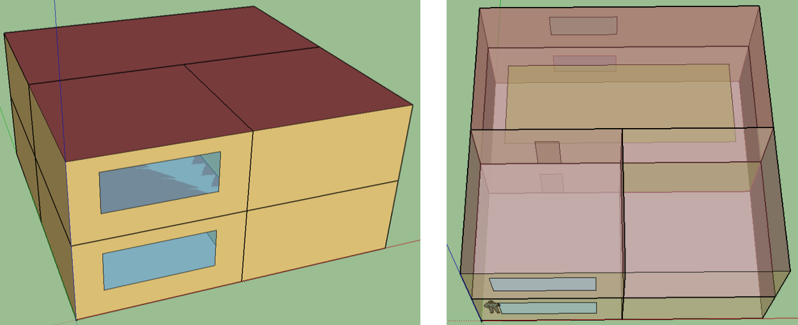
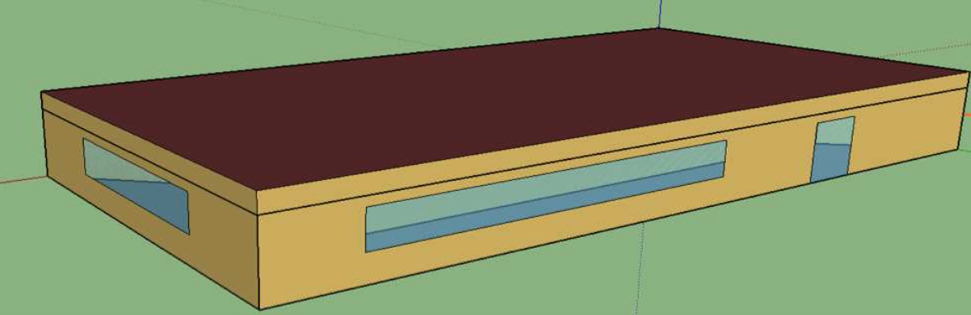
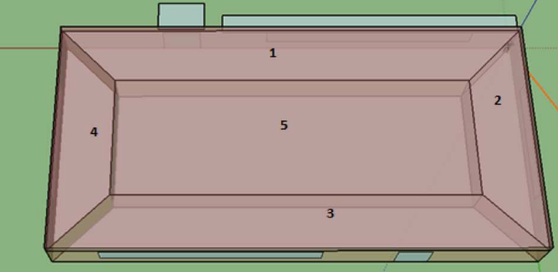
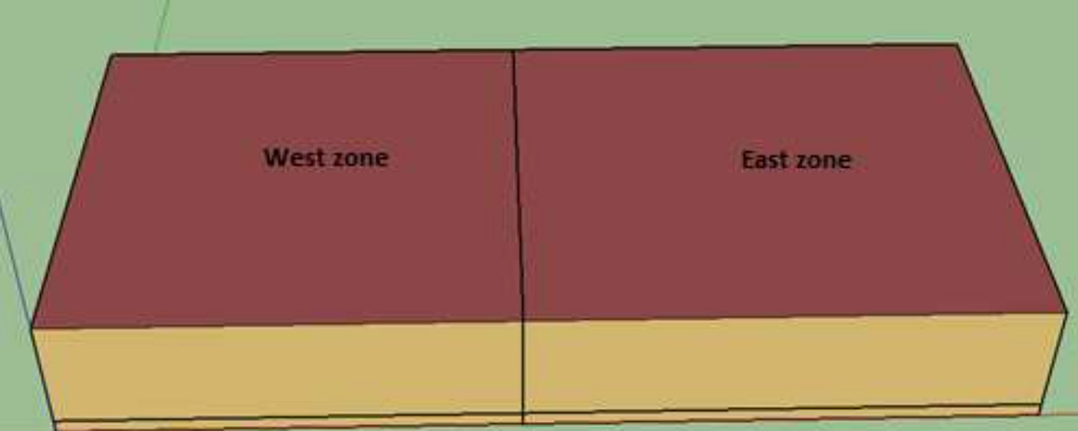
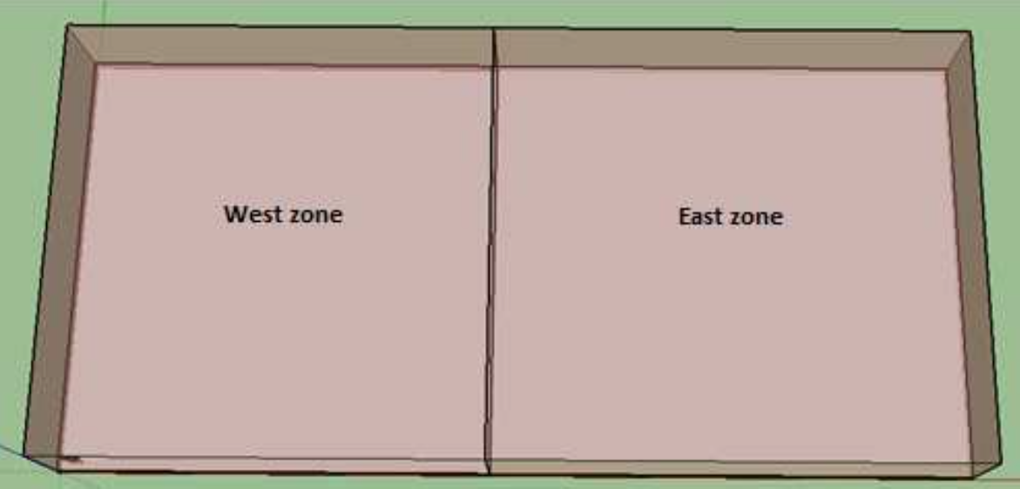
Building examples modeled in EnergyPlus
2-zone data center
5-zone office building
6-zone office building
6 zone office building
5 zone office building
2 zone data center building

Slide 9
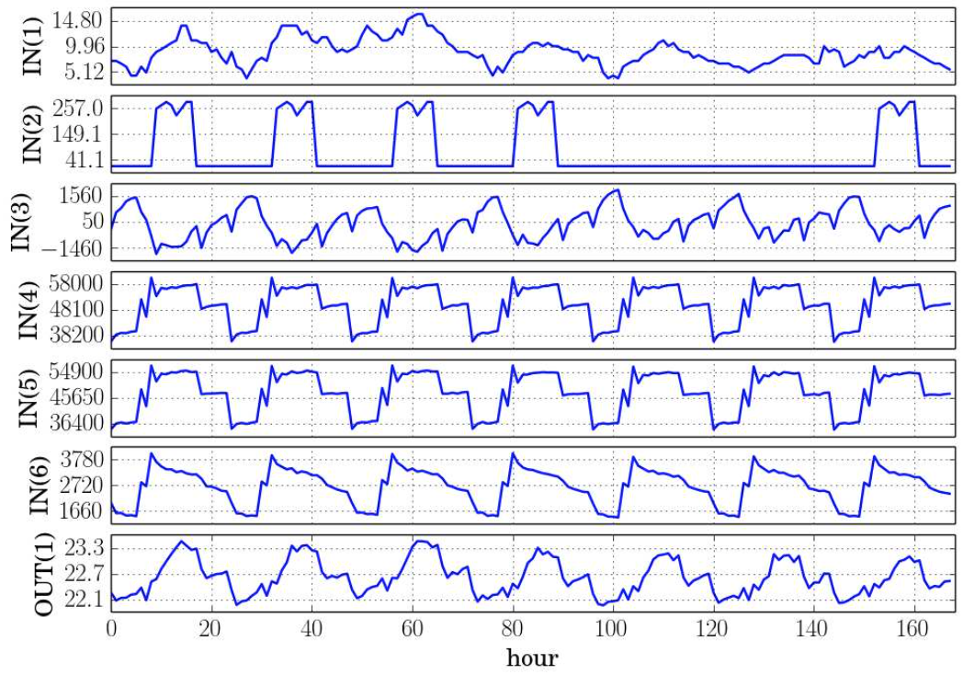
EnergyPlus Simulation Traces
INPUTS: Ambient temperature, people factors, equipment factors, HVAC inputs, etc.
OUTPUTS: Temperatures of the interested spaces/rooms
Ambient Temperature
Light Heating Rate
Electrical Equipment Heating Rate
Ambient Temperature
Air System Cooling Rate (Zones)
Air System Cooling Rate (Plenum)
Notes:
Plenum space, enclosed spaces (in buildings) used for airflow

Slide 10
Compact thermal for advanced linear and non-linear thermal control
Advanced control method is needed in order to minimize HVAC energy cost and meet the temperature goal
Linear models for model-based predictive control (MPC)
Nonlinear models for EKF: Extended Kalman Filter based control [2]
Computational cost is sensitive to number of state variables
We need a compact thermal model to describe the smart building system, with acceptable modeling error

Slide 11
Existing approach for compact thermal modeling for building
Model order reduction based approach
D. Kim and J. E. Braun, `Reduced-Order Building Modeling For Application to Model-Based Predictive Control‘’ in 5th National Conference of International Building Performance Simulation Association (IBPSA-USA), Aug. 2012, pp. 554--561.
Many assumption is made to linearize the thermal equations and boundary conditions
Truncated balanced realization (TBR) based reduction is used.
Aggregation-based reduction approach
K. Deng, P. Barooah, P.~G. Mehta, and S. P. Meyn, “Building Thermal Model Reduction via Aggregation of States'' in American Control Conference, June 30-July 02, 2010, Baltimore, MD, Baltimore, MD, Jun. 2010, pp. 5118--5123.
Performs localized reduction (aggregation) so that some network properties can be preserved.
The Ad-Hoc model reduction method method
B. Eisenhower and I. Mezic, `` Extracting Dynamic Information from Whole-building Energy Models'' in Proc. of Conference on Dynamics for Design (DFD 2012) Chicago, IL, Apr. 2012, pp. 3--10.
Extracts the basic linear dynamics of thermal behaviors of abuilding from the EnergyPlus program
Still many approximation and assumption are made and accuracy is a problem
All those methods are white-box based approach based on the thermal equations
They may suffer the accuracy issue and are difficult to use practically

Slide 12
Nonlinear thermal modeling for building
Nonlinear thermal modeling based on recurrent neural networks (RNN) based for building
Complicated building structures are essentially nonlinear
Thermal diffusion factors of many building materials are function of temperature
Thermal radiation effects is proportional to the T⁴ (T: temperature).
Recurrent neural networks are selected as RNN are very general nonlinear learning based modeling methods.
RNN is suitable for modeling dynamic systems
Need to select RNN architecture parameters
Need to mitigate overfitting

Slide 13
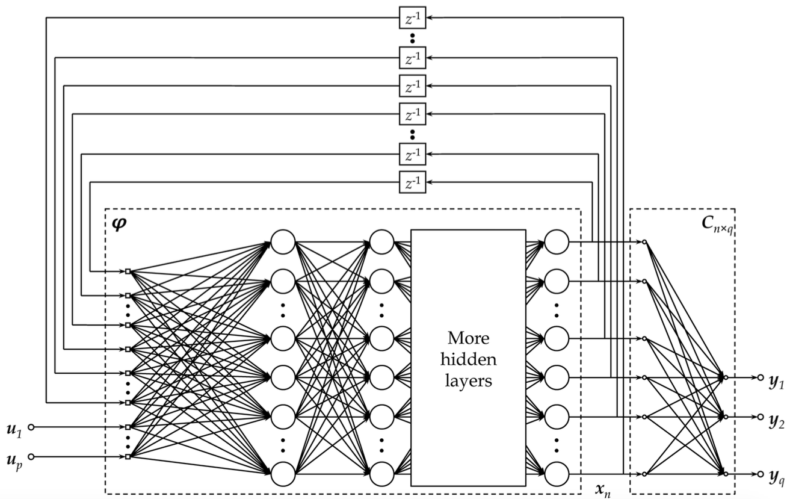
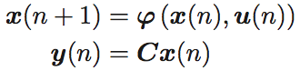
NLSS architecture
NLSS: Non-linear State Space neural network [3]
Closer to non-linear state space representation
Slightly higher variance in experiment

Slide 14
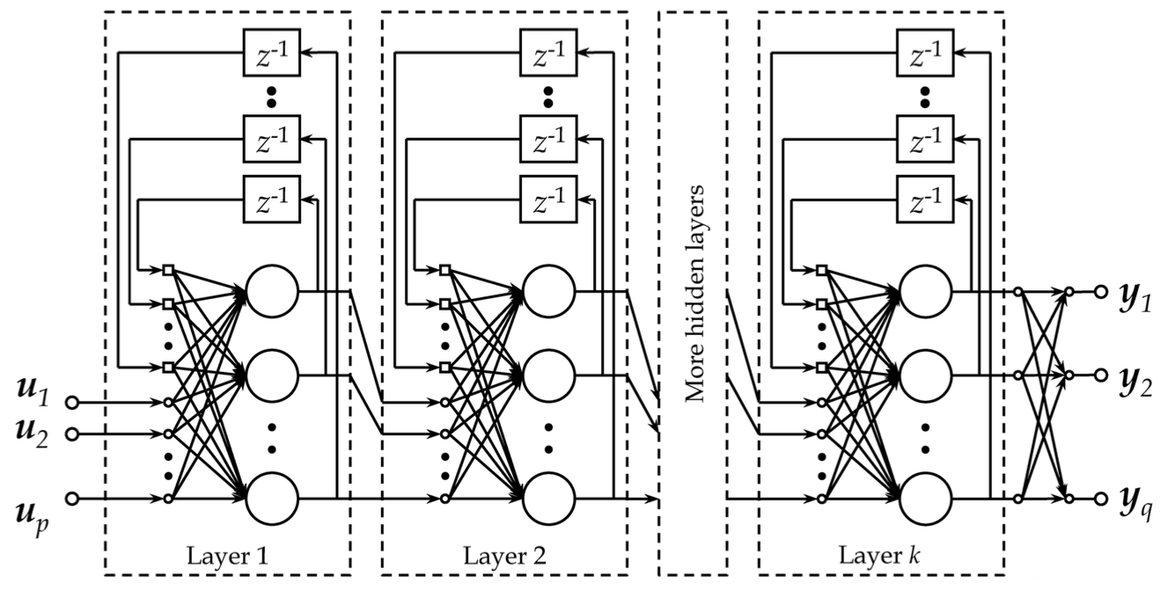
ELNN architecture
ELNN: Elman’s Neural Network [4] with local feedbacks
More works to extract the state variables (since they are everywhere with each layer)
Slightly lower variance in experiment
Popular for voice recognition in deep learning

Slide 15
RNN for thermal model of building
Programmed in Python, with libraries PyBrain [5], NumPy [6], SciPy [7], Matplotlib [8]
2-norm regularization enabled in training to mitigate the over-fitting problem
We use RPropMinus [9], an adaptive back-propagation algorithm to train the RNNs
Input data is normalized before fed into the trainer to speed up training
Baseline data configuration:
The data set consists of temperature for one year recorded in hourly basis.
Months 1-3, 5-7, 9-11 for training, 4, 8, 12 for validation

Slide 16
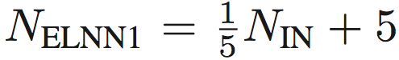


Network configurations
Empirical number of layers:
2 hidden layers for ELNN, 4 hidden layers for NLSS
Empirical determination of layer sizes:
ELNN
Hidden layer #1:
Hidden layer #2:
NLSS
Hidden layer #1-3:
Hidden layer #4:
Example: NLSS in 2-zone (all factors, #IN=11, #OUT=2): Uses layers with size (20, 20, 20, 2)

Slide 17
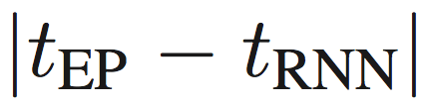
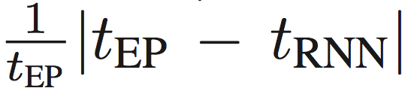
Error calculation
On each sampled output, we use two methods to calculate the modeling error
Absolute error: the actual difference between RNN output and EnergyPlus output:
Relative error: Absolute error divided by EnergyPlus output:
Average and maximum statistics are also calculated over the whole training data and validation data respectively

Slide 18
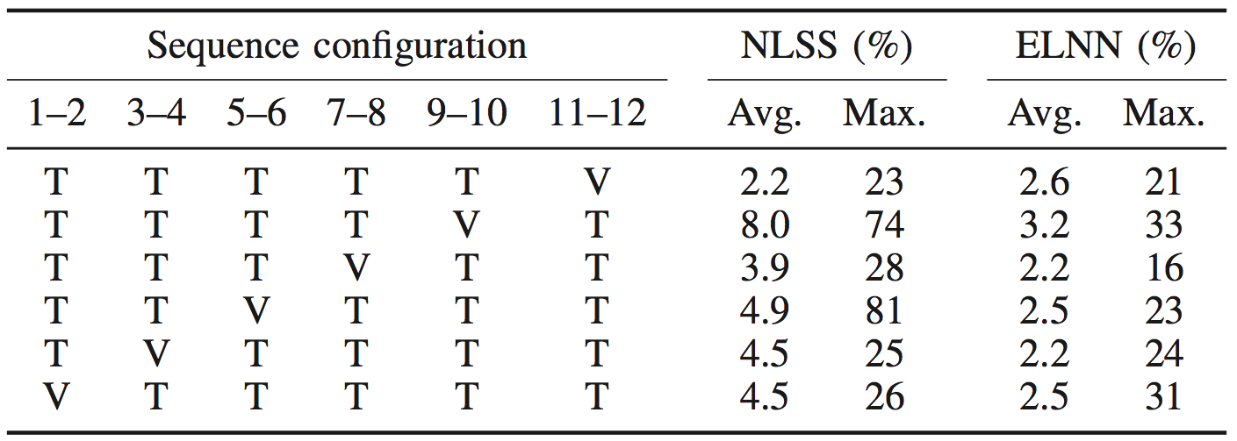
Cross validation for accuracy improvement
We use every adjacent 2 months as a group
In each run of cross validation, we use one group to validate the model trained by the rest 5 groups
In 6-zone building RNNs
Validation error reduced from 34% to 23% in NLSS; from 23% to 16% in ELNN

Slide 19
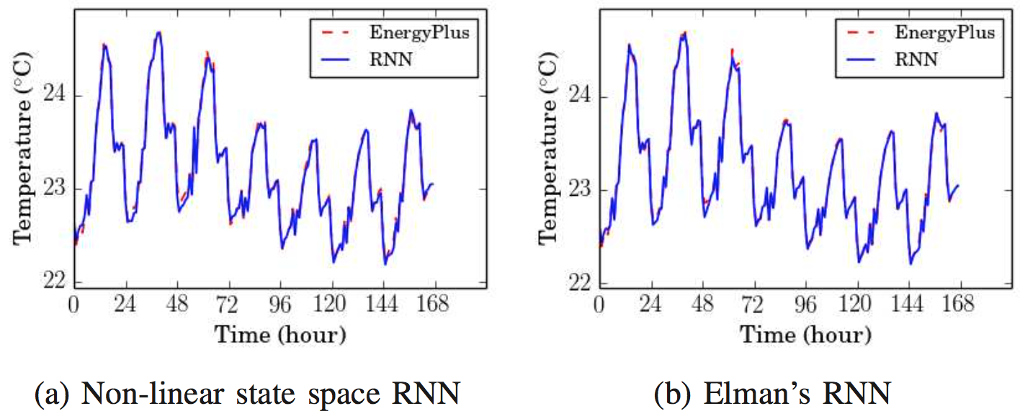
2-zone building (all factors) modeling result
#IN=11, #OUT=2
Average error
ELNN 0.022°C/0.10%; NLSS 0.026°C/0.11%
Maximum error
ELNN 0.24°C/1.1%; NLSS 0.21°C/0.94%

Slide 20
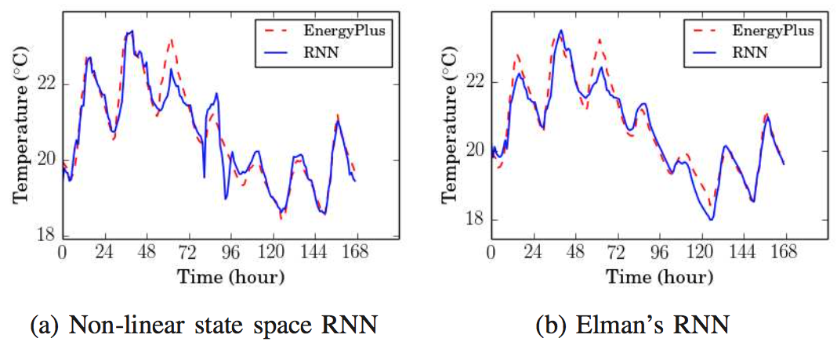
2-zone building (HVAC) modeling result
#IN=3, #OUT=2
Average error
ELNN 0.20°C/0.98%; NLSS 0.23°C/1.2%
Maximum error
ELNN 1.34°C/6.5%; NLSS 1.4°C/7.0%

Slide 21
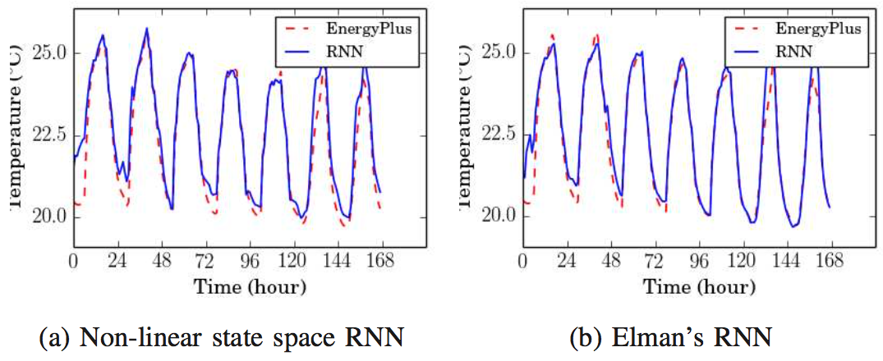
5-zone building (all factors) modeling result
#IN=26, #OUT=5
Average error
ELNN 0.23°C/1.0%; NLSS 0.31°C/1.4%
Maximum error
ELNN 4.4°C/16%; NLSS 4.6°C/20%

Slide 22
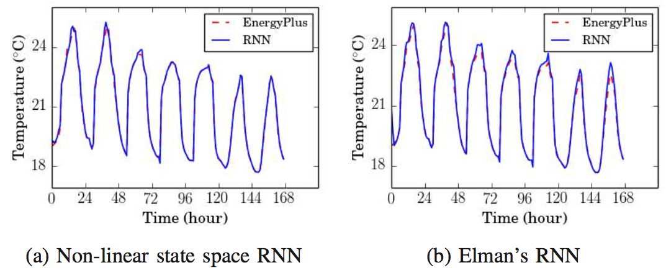
5-zone building (HVAC) modeling result
#IN=6, #OUT=5
Average error
ELNN 0.16°C/0.71%; NLSS 0.057°C/0.26%
Maximum error
ELNN 2.2°C/12%; NLSS 2.2°C/9.6%

Slide 23
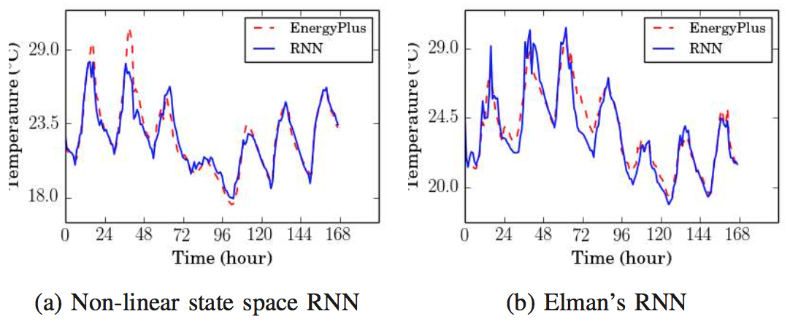
6-zone modeling result
#IN=55, #OUT=6
Average error
ELNN 0.53°C/2.2%; NLSS 0.48°C/2.2%
Maximum error
ELNN 4.1°C/16%; NLSS 4.8°C/23%

Slide 24
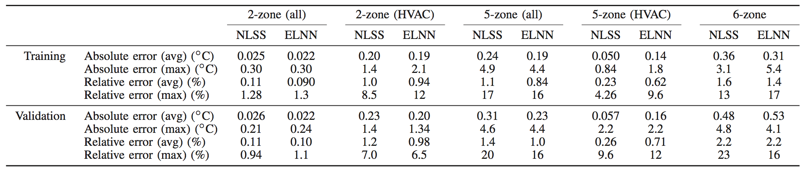
Summary for RNN-based method
We did experiments on two RNN architectures on building thermal models
ELNN: Elman’s Neural Network with local feedbacks
NLSS: Non-Linear State Space Neural Network
We used cross-validation to reduce the modeling error on the 6-zone building case
Modeling errors
2-zone and 5-zone models: 1% ~ 1.5% average error
2-zone and 5-zone models: 1.1% ~ 20% maximum error
Bigger 6-zone model: ELNN 2.2% and NLSS 2.2% for average error
Bigger 6-zone model: ELNN 16% and NLSS 23% for maximum error

Slide 25
Linear thermal modeling for building
Applied subspace system identification (SID) method to build the dynamic linear thermal model
Thermal system is weakly nonlinear. Within certain temperature range and conditions, it can be viewed as linear models
Linear models are more amenable for thermal controls
Model-based predictive control (MPC) for energy-efficient HVAC and client demand control
Kalman filter based thermal estimation and control

Slide 26
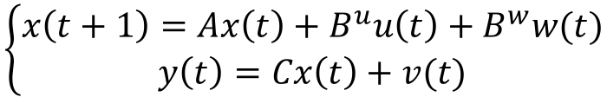
Behavioral thermal modeling problem
Described as a discrete linear time invariant (LTI) system
p0
p1
p2
p3
p4
t0
t1
t2
t3
t4
$$\left\{\begin{aligned}x\left(t+1\right)=Ax\left(t\right)+B^{u}u\left(t\right)+B^{w}w(t) \\ y\left(t\right)=Cx\left(t\right)+v(t)\end{aligned}\right.$$
A: stable matrix u: input matrix
y: output matrix x: state matrix

Slide 27
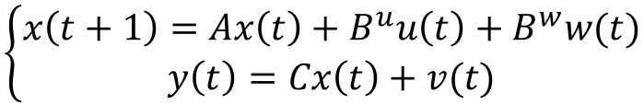
Subspace System Identification^{[1]}
State space models (LTI)
Here input u is Power, and output y is Temperature
Goal
Given input and output observations u and y, find an appropriate order n and the system matrices {A, B^{u}, C}
$$\left\{\begin{aligned}x\left(t+1\right)=Ax\left(t\right)+B^{u}u\left(t\right)+B^{w}w(t) \\ y\left(t\right)=Cx\left(t\right)+v(t)\end{aligned}\right.$$
Considering
Noise!
A : stable matrix w,v : stationary zero-mean white-noise seq.
u/y : input/output
[1] N.Y. Chen, J.S. Gibson, “Subspace System Identification Using a Multichannel Lattice Filter”, Proc. American Control Conference, 2004, Volume 1, Issue 30, pp. 855 - 860
Notes:
A is a stable matrix. The sequences w, and v are stationary zero-mean white noise sequences. Only the
sequences y and U are measured. Our goal is to use the measured y and U to identify unbiased system matrices
(A, B", C).
recursive least-squares (RLS) estimation.

Slide 28
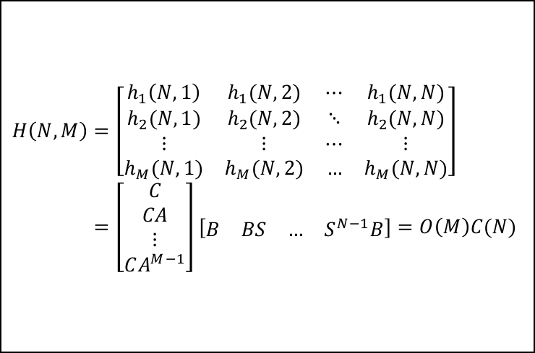
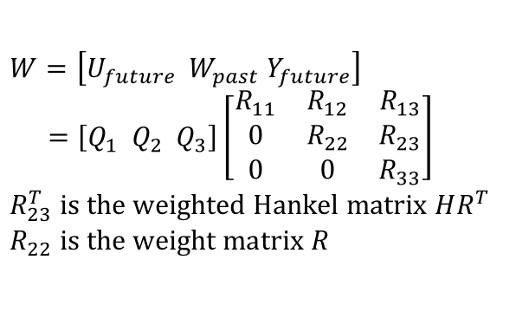
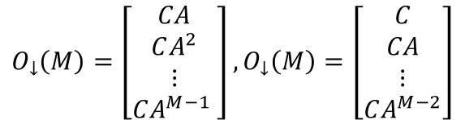
SID algorithm flow see [1] for more details
Input/Ouput Data
u(t), y(t)
Weighted
Hankel Matrix
HR^{T}
QR
SVD
HR^{T}=UΣV^{T}
$$W=\left[U_{future} W_{past} Y_{future}\right] \\ =\left[Q_{1} Q_{2} Q_{3}\right]\left[\begin{matrix}R_{11} & R_{12} & R_{13} \\ 0 & R_{22} & R_{23} \\ 0 & 0 & R_{33}\end{matrix}\right] \\ R_{23}^{T} is the weighted Hankel matrix HR^{T} \\ R_{22} is the weight matrix R$$
Reduced SVD
HR^{T}=U_{r}Σ_{r}V_{r}^{T}
Extended Observability
/Controllability Matrix
O(M)=U_{r}Σ_{r}^{1/2}
C(N)= Σ_{r}^{1/2}V_{r}^{T}(R^{T})⁻¹
$$H\left(N,M\right)=\left[\begin{matrix}h_{1}\left(N,1\right) & h_{1}(N,2) & ⋯ & h_{1}(N,N) \\ h_{2}(N,1) & h_{2}(N,2) & ⋱ & h_{2}(N,N) \\ ⋮ & ⋮ & ⋯ & ⋮ \\ h_{M}(N,1) & h_{M}(N,2) & … & h_{M}(N,N)\end{matrix}\right] \\ =\left[\begin{matrix}C \\ CA \\ ⋮ \\ CA^{M−1}\end{matrix}\right]\left[\begin{matrix}B & BS & … & S^{N−1}B\end{matrix}\right]=O\left(M\right)C(N)$$
C = first top block row of O(M)
[F(t) B^{u}]=first left block column of C(N)
$$O_{↓}\left(M\right)=\left[\begin{matrix}CA \\ CA^{2} \\ ⋮ \\ CA^{M−1} \end{matrix}\right], O_{↓}\left(M\right)=\left[\begin{matrix}C \\ CA \\ ⋮ \\ CA^{M−2}\end{matrix}\right]$$
Notes:
This figure illustrates the basic steps in subspace identification of a state space model of a linear time invariant
(LTI) system.

Slide 29
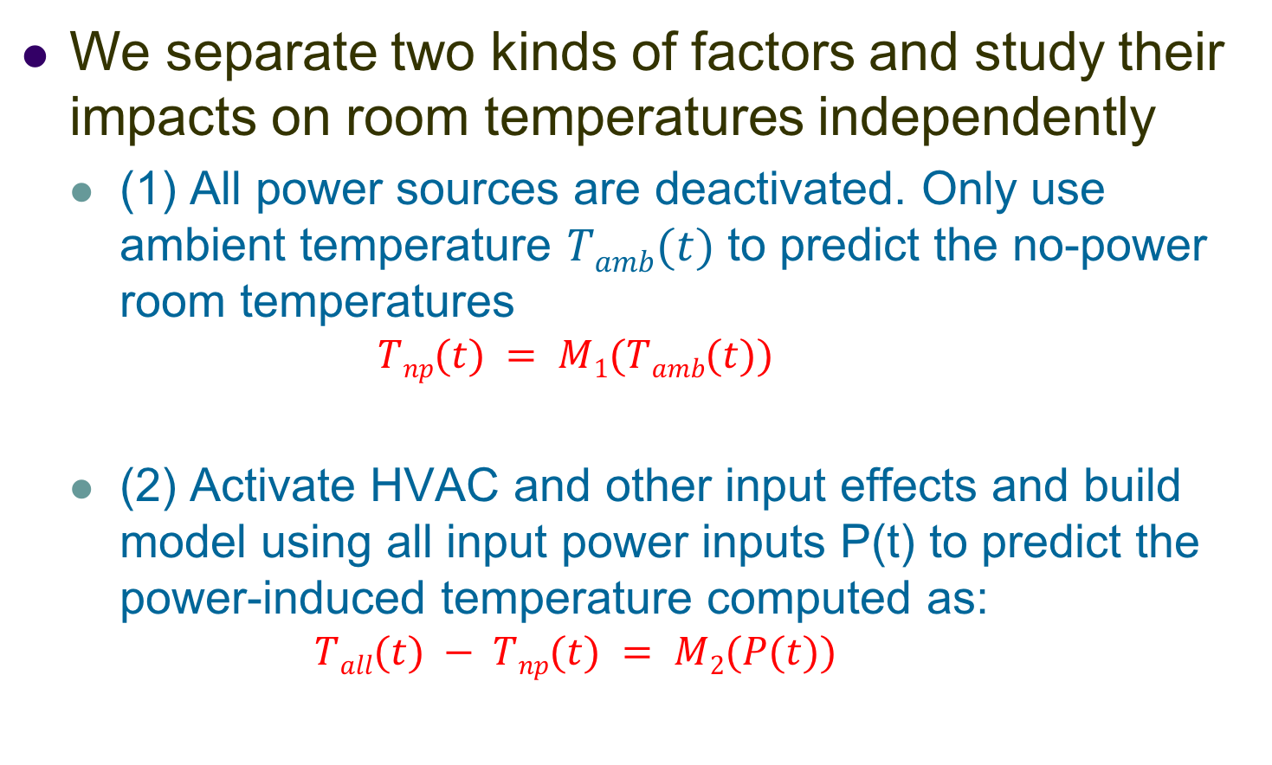
Input impact study
We separate two kinds of factors and study their impacts on room temperatures independently
(1) All power sources are deactivated. Only use ambient temperature $Tamb(t)$ to predict the no-power room temperatures
$$Tnp(t) = M1(Tamb(t))$$
(2) Activate HVAC and other input effects and build model using all input power inputs P(t) to predict the power-induced temperature computed as:
$$Tall(t) − Tnp(t) = M2(P(t))$$

Slide 30
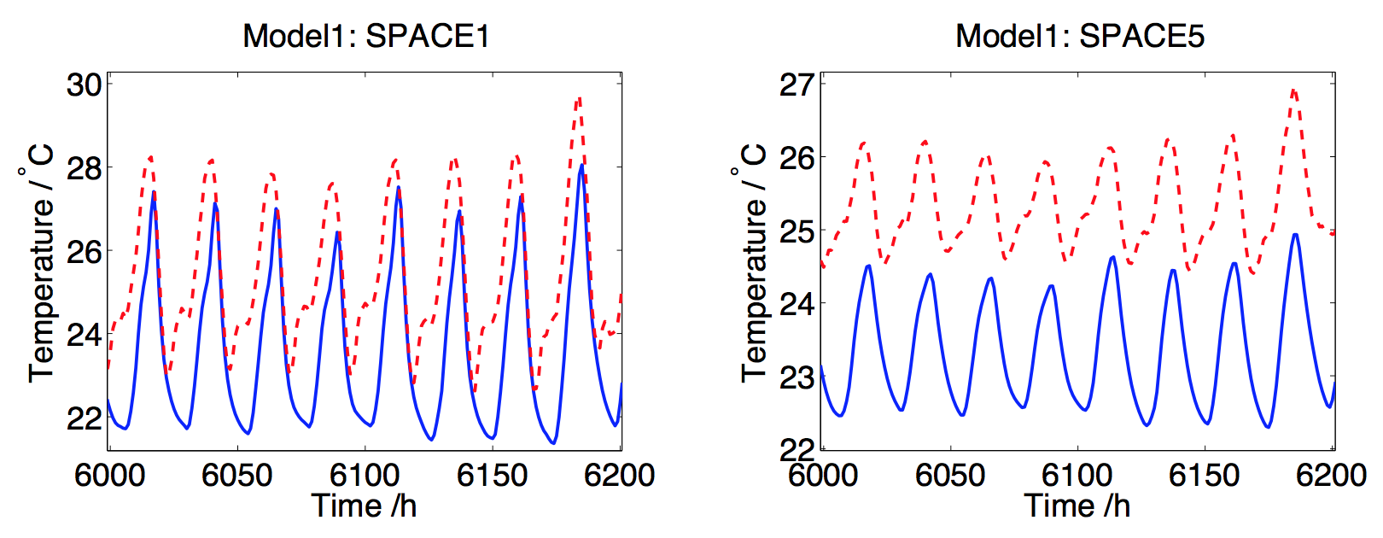
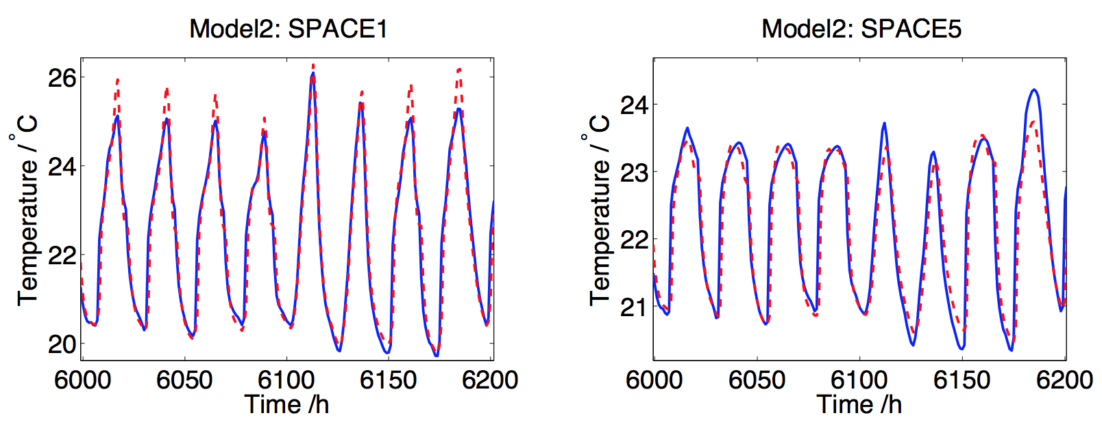
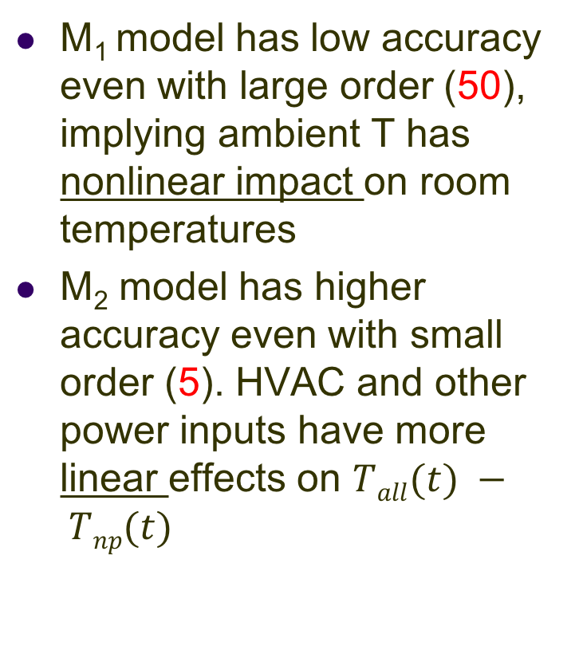
Input impact study results
M₁ model has low accuracy even with large order (50), implying ambient T has nonlinear impact on room temperatures
M₂ model has higher accuracy even with small order (5). HVAC and other power inputs have more linear effects on $Tall(t) − Tnp(t)$

Slide 31
Model order selection to avoid overfitting
Done various optimization which includes selecting a proper order.
For this order study, the best order seen below is 37. After many trials, we found an acceptable order.

Slide 32
5-zone building results (training phase)
For 5-zone building, only one zone and the first 500 hours shown below

Slide 33
5-zone building results (validation phase)

Slide 34
Absolute and relative errors for 5-zone building
Five zone with HVAC only considering ambient temperature
 |  | SPACE 1 | SPACE 2 | SPACE 3 | SPACE 4 | SPACE 5
Testing | Relative RMS Error | 0.0150 | 0.0165 | 0.0138 | 0.0136 | 0.0120
 | Max Relative Error | 0.0879 | 0.0825 | 0.0958 | 0.0927 | 0.0900
 | Absolute RMS Error | 0.3078 | 0.3372 | 0.2752 | 0.2739 | 0.2482
 | Max Absolute Error | 1.8780 | 1.7701 | 2.0544 | 1.9978 | 1.9546
Validation | Relative RMS Error | 0.0267 | 0.0290 | 0.0187 | 0.0199 | 0.0166
 | Max Relative Error | 0.1510 | 0.1868 | 0.1438 | 0.1463 | 0.1375
 | Absolute RMS Error | 0.5707 | 0.6267 | 0.3874 | 0.4157 | 0.3538
 | Max Absolute Error | 2.7525 | 4.1471 | 3.2361 | 3.3607 | 3.1209
Five zone with HVAC and considering extra factors
 |  | SPACE 1 | SPACE 2 | SPACE 3 | SPACE 4 | SPACE 5
Testing | Relative RMS Error | 0.0153 | 0.0167 | 0.0132 | 0.0139 | 0.0088
 | Max Relative Error | 0.0792 | 0.0948 | 0.0759 | 0.0788 | 0.0598
 | Absolute RMS Error | 0.3297 | 0.3620 | 0.2742 | 0.2919 | 0.1900
 | Max Absolute Error | 1.7938 | 2.0272 | 1.6310 | 1.6794 | 1.3117
Validation | Relative RMS Error | 0.0320 | 0.0333 | 0.0187 | 0.0203 | 0.0145
 | Max Relative Error | 0.1594 | 0.1690 | 0.0786 | 0.0930 | 0.0650
 | Absolute RMS Error | 0.7247 | 0.7520 | 0.3947 | 0.4352 | 0.3187
 | Max Absolute Error | 4.3228 | 4.6669 | 1.6876 | 2.0009 | 1.4297

Slide 35
Results for 2-zone building
Two zone with HVAC and extra factors
 |  | SPACE 1 | SPACE 2
Testing | Relative RMS Error | 0.0021 | 0.0022
 | Max Relative Error | 0.0128 | 0.0144
 | Absolute RMS Error | 0.0476 | 0.0488
 | Max Absolute Error | 0.2959 | 0.3235
Validation | Relative RMS Error | 0.0041 | 0.0060
 | Max Relative Error | 0.0214 | 0.0229
 | Absolute RMS Error | 0.0939 | 0.1338
 | Max Absolute Error | 0.4912 | 0.5164
For 2-zone, only one zone and first 500 hours are shown below

Slide 36
Summary for SID based method
Ambient temperature has nonlinear impacts on the zone temperature
5-zone (all factors)
1.4 - 3.3% average relative error
6.5 – 16.9% max relative error
5-zone (HVAC only)
1.7 – 2.9% average relative error
13.8 – 18.7% max relative error
2-zone (all factors)
0.4 – 0.6% average relative error
2.1 – 2.3% max relative error

Slide 37
References
Reference
[1] Building Energy Data Book of DOE. [Online]. http: //buildingsdatabook.eren.doe.gov
[2] M. Massoumy, Q. Zhu, C. Li, F. Meggers, and A. Sangiovanni-Vincentelli, “Co-design of Control Algorithm and Embedded Platform for Building HVAC Systems,” in International Conference on Cyber Physical Systems (ICCPS), Philadephia, PA, Apr. 2013, pp. 61–70.
[3] S. Haykin and N. Network, “A comprehensive fundation,” Neural Networks, vol. 2, no. 2004, 2004.
[4] J. L. Elman, “Finding structure in time,” Cognitive science, vol. 14, no. 2, pp. 179–211, 1990.
[5] T. Schaul, J. Bayer, D. Wierstra, Y. Sun, M. Felder, F. Sehnke, T. Ru ̈ckstieß, and J. Schmidhuber, “PyBrain,” Journal of Machine Learning Research, vol. 11, pp. 743–746, 2010.
[6] S. Van Der Walt, S. C. Colbert, and G. Varoquaux, “The numpy array: a structure for efficient numerical computation,” Computing in Science & Engineering, vol. 13, no. 2, pp. 22–30, 2011.
[7] E. Jones, T. Oliphant, P. Peterson et al., “SciPy: Open source scientific tools for Python,” 2001–, [Online; accessed 2015-07-23]. [Online]. Available: http://www.scipy.org/
[8] J. D. Hunter, “Matplotlib: A 2d graphics environment,” Computing in science and engineering, vol. 9, no. 3, pp. 90–95, 2007.
[9] C. Igel and M. Hu ̈sken, “Empirical evaluation of the improved rprop learning algorithms,” Neurocomputing, vol. 50, pp. 105–123, 2003.

Slide 38
Acknowledgement
Graduate students: Hengyang Zhao, Shunjian Wang, Daniel Quach, Jian Ma.
Prof. Xin Li of CMU and Prof. Hai Wang of UESTC for the collaborations.
Prof. Qi Zhu of UCR for introducing the EngeryPlus program and smart building concepts.

Slide 39
Questions???

